Slide 1


NEXT GEN EMPLOYABILITY PROGRAM
CREATING A FUTURE-READY WORKFORCE
Student Name :
Aadi Siva Kartheek Pamarthi
Student ID :
STU63974084c99531670856836
Mobile No:
8179127833
Mail ID:
pamarthiaadi9@gmail.com
College Name :
Velagapudi Ramakrishna Siddhartha Engineering College

Slide 2
CAPSTONE PROJECT SHOWCASE
Project Title
Power Bi Driven Exhaustive Analysis of Indian Agriculture Sector
Abstract | Problem Statement | Project Overview | Proposed Solution | Technology Used | Modelling & Results | Conclusion | Q&A

Slide 3
Abstract
1
Utilizing Power BI, this project conducts a comprehensive analysis of the Indian agricultural sector, amalgamating diverse data sources to provide actionable insights.
2
The integration of government databases, market reports, and satellite imagery enables the creation of intuitive and interactive dashboards, facilitating exploration of agricultural trends and patterns.
3
Through in-depth sectoral analysis, including crop yields, land utilization, and market prices, the project aims to support stakeholders and policymakers in strategic decision-making.
4
The findings not only offer guidance to farmers and policymakers but also pave the way for future research endeavors, emphasizing the transformative potential of data-driven approaches in addressing challenges in the Indian agriculture sector.

Slide 4


Problem Statement
The lack of comprehensive and real-time insights in the Indian agricultural sector necessitates the application of Power BI for integrating diverse data sources to address challenges and support informed decision-making.

Slide 5

Project Overview
The project aims to utilize Power BI to conduct an in-depth analysis of the Indian agricultural sector by integrating diverse data sources such as government databases, market reports, and satellite imagery. Through the creation of interactive dashboards, the project seeks to provide stakeholders with comprehensive insights into agricultural trends, market dynamics, and socio-economic factors, facilitating informed decision-making and policy formulation.

Slide 6
Proposed Solution
The proposed solution involves leveraging Power BI's capabilities to integrate diverse data sources, including government databases, market reports, and satellite imagery, to conduct comprehensive analysis of the Indian agricultural sector. By developing interactive dashboards and employing advanced analytics techniques, such as predictive modeling and trend analysis, the solution aims to provide stakeholders with actionable insights into crop yields, land utilization, market prices, and other key parameters. This approach will enable informed decision-making, support policy formulation, and empower stakeholders to address challenges and capitalize on opportunities within the Indian agricultural landscape.

Slide 7
Power BI: The primary technology used for data integration, visualization, and dashboard creation.
Data Integration Tools: Various tools and techniques are employed for integrating diverse data sources, including government databases, market reports, and satellite imagery, into a cohesive dataset suitable for analysis within Power BI.
Advanced Analytics Techniques: Predictive modeling, trend analysis, and statistical methods are utilized within Power BI to extract actionable insights from the integrated dataset, providing stakeholders with valuable information for decision-making.
Technology used

Slide 8
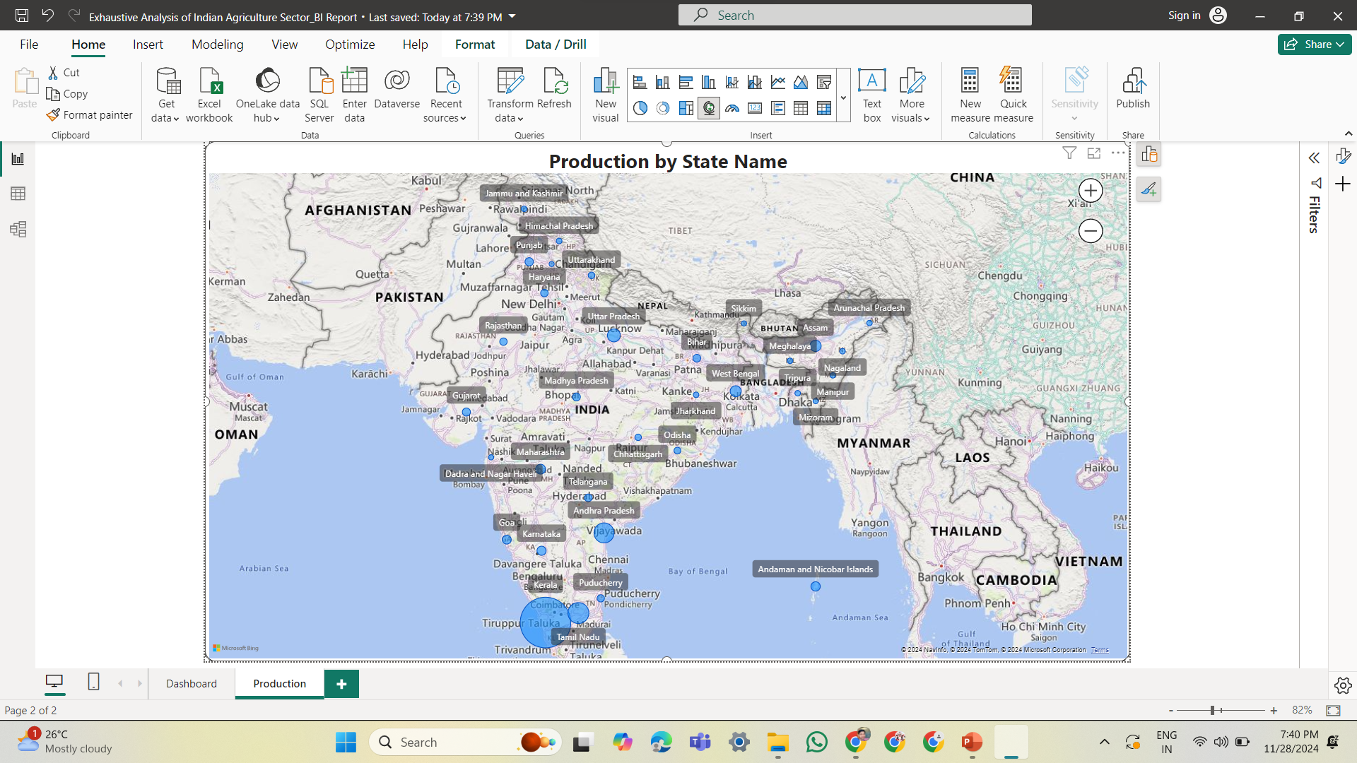
Modelling & Result

Slide 9
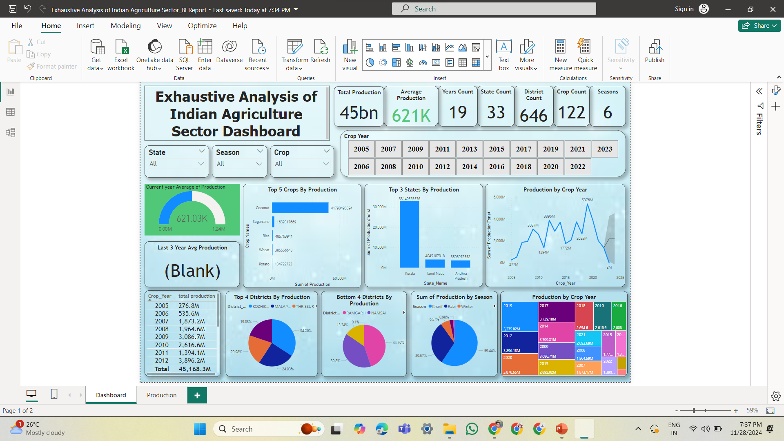
Modelling & Result

Slide 10

Conclusion
In conclusion, the project successfully demonstrates the effectiveness of utilizing Power BI for conducting comprehensive analysis of the Indian agricultural sector. By integrating diverse data sources and employing advanced analytics techniques, stakeholders are empowered with actionable insights into agricultural trends, market dynamics, and socio-economic factors. The interactive dashboards generated provide a user-friendly platform for informed decision-making and policy formulation. Moving forward, the project sets a precedent for leveraging technology-driven approaches to address challenges and unlock opportunities within the agricultural landscape, emphasizing the transformative potential of data analytics in driving sustainable growth and development.

Slide 11


Notes:
Thank You !!

